Slide 1
Machine Learning for games
AUTO DRIVE
ISHITA BEDI
KAUSHIK SHAKKARI
NAMITA ATRI
PRANAV GUPTA
RAJAT AGARWAL

Slide 2

PROJECT IDEA
Self Driving Bot
GTA V
Transfer Learning
Physical Car

Slide 3
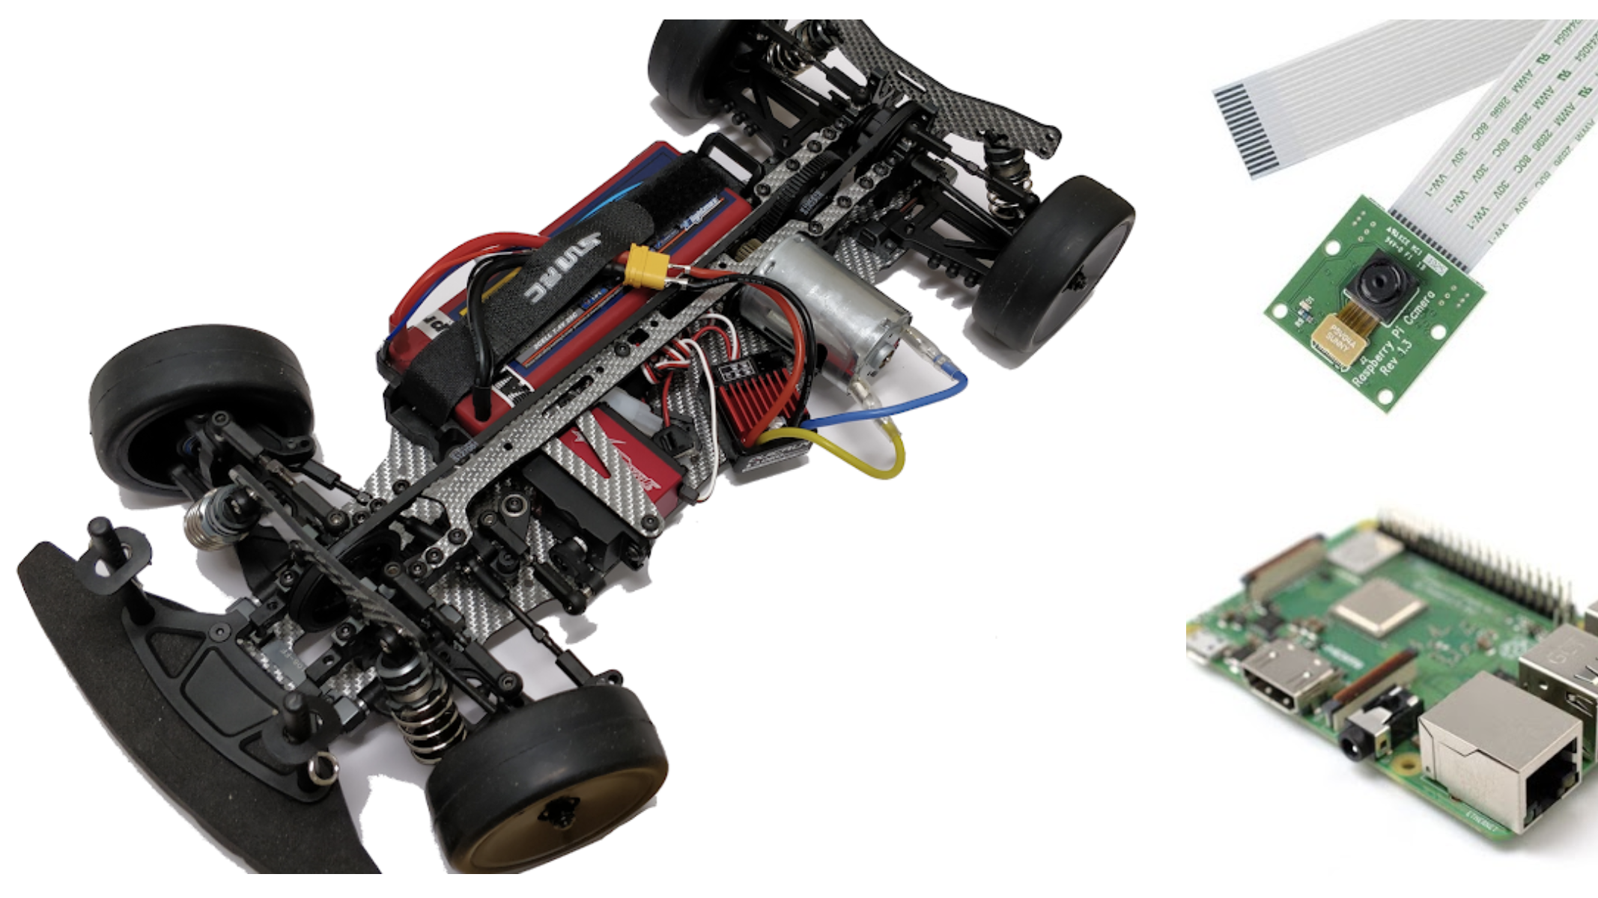
Raspberry pi 3
2–cell LiPo battery
Brushed Motor
Camera

Slide 4
Technologies
Raspberry pi (Sensor)
Open CV (Game + Physical Camera)
Reinforcement Learning
Deep Neural Networks

